Slide 1
Introduction to Visual Studio.Net

Slide 2
Agenda
Framework
.NET Framework Introduction
.NET Framework Architecture
.NET Framework Versions
Microsoft Visual Studio versions
.NET Framework 1.0, 1.1, 2.0, 3.0, 3.5, 4.0
.NET Framework Technologies
Certifications

Slide 3
Framework
Framework is a defined support structure in which another software project can be organized and developed
Framework are designed to meeting software requirement rather than providing the working system
Framework can be considered as the processes and technologies used to solve a complex issue
It is the skeleton upon which various objects are integrated for a given solution

Slide 4
.NET Framework Introduction
.NET Framework is a software component
It gives operating system features and responsibilities
It supports building and running the next generation of applications and XML Web services
It consists of Common Language Runtime and Base Class Library

Slide 5
.NET Framework Architecture
VB
C#
C++
J#
Others
Common Language Specification
Web Service
User Interface
Visual Studio .NET
ADO.NET:Data and XML
Base Class Library
Common Language Runtime (CLR)

Slide 6
Common Language Runtime
  CLR manages code execution at runtime
  Memory management, thread management, etc.
Common Language Runtime
Operating System

Slide 7
Base Class Library
  Object-oriented collection of reusable types
  Collections, I/O, Strings, …
.NET Framework (Base Class Library)
Common Language Runtime
Operating System

Slide 8
Data Access Layer
  Access relational databases
  Disconnected data model
  Work with XML
  Access relational databases
  Disconnected data model
  Work with XML
ADO .NET and XML
.NET Framework (Base Class Library)
Common Language Runtime
Operating System

Slide 9
Asp.NET & Windows Forms
  Create application’s front-end – Web-based user interface, Windows GUI, Web services, …
ASP .NET
Web Forms Web Services
Mobile Internet Toolkit
Windows
Forms
ADO .NET and XML
.NET Framework (Base Class Library)
Common Language Runtime
Operating System

Slide 10
Programming Languages
  Use your favorite language
C++
C#
VB
Perl
J#
…
ASP .NET
Web Forms Web Services
Mobile Internet Toolkit
Windows
Forms
ADO .NET and XML
.NET Framework (Base Class Library)
Common Language Runtime
Operating System

Slide 11

Common Language Specification
C++
C#
VB
Perl
J#
…
ASP .NET
Web Forms Web Services
Mobile Internet Toolkit
Windows
Forms
ADO .NET and XML
.NET Framework (Base Class Library)
Common Language Runtime
Operating System

Slide 12
Visual Studio .NET
C++
C#
VB
Perl
J#
…
Visual Studio .NET
Common Language Specification
ASP .NET
Web Forms Web Services
Mobile Internet Toolkit
Windows
Forms
ADO .NET and XML
.NET Framework (Base Class Library)
Common Language Runtime
Operating System

Slide 13



Standard Compliance
C# Language – Submitted to ECMA
C++
C#
VB
Perl
J#
…
Visual Studio .NET
Common Language Specification
Open Language
Specification
ASP .NET
Web Services Web Forms
Mobile Internet Toolkit
Windows
Forms
Web services –
XML, SOAP-based
ADO .NET and XML
.NET Framework (Base Class Library)
XML-based
data access
Common Language Runtime
Operating System

Slide 14
A Look Back…
SP1
3.5
3.0
.NET 1.0
.NET 1.1
.NET 2.0
.NET 4
2002
2003
2005-08
2008 CTP
CLR 1.0
CLR 1.1
CLR 2.0
CLR 4

Slide 15
The .NET framework 4.0
WPF
Win Forms
DLR
ASP.NET
WCF
LINQ
And more!
Base Class Libraries
The CLR
JIT & NGEN
Garbage Collector
Security Model
Exception Handling
Loader & Binder

Slide 16
.NET Framework Components
Following are the major components of .NET Framework:
Common Language Specification (CLS)
.NET Framework Languages
.NET Framework Base Class Library (BCL - FCL)
Common Language Runtime (CLR)

Slide 17
Common Language Specification (CLS)
An Important goal of .NET Framework is to support multiple languages.
But all languages are not created equal so it is important to agree upon a common subset that all languages will support
The Common Language Specification is an agreement among languages.
The CLS defines the minimum standards that .NET languages must confirm.
Common Language Specification provides a series of basic rules that are required for language integration.

Slide 18
.NET Framework Languages
The .NET Framework is language neutral – an application written in VB.NET can access a application written in C# which also can access the application written in J# and so on.
Third parties are providing additional languages (over a dozen so far) Following are few of them
APL
C++
C#
COBOL
Pascal
VB
Eiffel
Smalltalk
SML
J#
JScript
Mercury
Oz
Perl
Python

Slide 19
.NET Framework Class Library
The .NET Framework Class Library provides a collection of useful and reusable classes that can be utilized across multiple languages
The classes provided by .NET Framework are object-oriented and fully extendable.
All of these classes are logically grouped in to “Namespaces”.

Slide 20
BCL/FCL Namespaces
System
System.Security
System.NET
System.Web
System.Threading
System.IO
System.Xml
System.Data

Slide 21
Common Language Runtime (CLR)
CLR is the heart of .NET Framework. CLR manages execution of .NET code and provides useful services.
The basic function of CLR is to take the code generated by the C# compiler or any other compiler and converts it to the native language.
Traditionally there are different runtime for different programming environments.
Examples of runtimes include the standard C library, the Visual Basic runtime and Java Virtual Machine.

Slide 22
Common Type System (CTS)
.NET Framework also defines CTS which defines what types are allowed to run inside the framework.
The CTS provides a wide range of types and operations that are found in many programming languages.
The CTS provides a framework for cross-language integration.
Due to this there is no difference between Integer in VB.NET and int in C#, they are System.Int32 according to CTS.
VB.NET
System.Int32
C#
Integer
System.Int32
int
CTS Type

Slide 23
Microsoft Intermediate Language (MSIL)
When a .NET application is compiled it is converted from the language it was written in (VB.NET, C#, J# etc) to a Managed Module.
This Managed Module contain MSIL which is direct compiled form of your code and metadata.
MSIL is a low level set of instructions understood by Common Language Runtime.

Slide 24
Compiling Source into Managed Module
C#
Source Code
VB.NET
Source Code
J#
Source Code
C#
Compiler
VB.NET
Compiler
J#
Compiler
Managed Module
MSIL and metadata
Managed Module
MSIL and metadata
Managed Module
MSIL and metadata

Slide 25
Structure of Managed Module
Metadata
MSIL
Type 1
Fields
Properties
Methods
Events
Type 2
Fields
Properties
Methods
Events

Slide 26
Metadata / Manifest data
Every managed module contains metadata that describe the two things:
1. The types (classes) and members defined in your source code.
2. The types (classes) and members referenced by your source code.
Metadata is always associated with the file that contain the IL code.

Slide 27
Just in Time Compiler (JIT)
Before executing on the target machine, MSIL is translated by just-in-time (JIT) compiler to native code.
Some code typically will never be executed during a program run.
Hence it may be more efficient to translate MSIL as needed during execution, storing the native code for reuse.

Slide 28
.NET Assembly
The primary unit of a .NET application is the assembly. An assembly is a self describing collections of one or more managed modules and resource files.
An assembly is the smallest unit of reuse, security and versioning.
Assembly manifest provides information about what is contained within the assembly.

Slide 29
Structure of .NET Assembly
Metadata
Metadata
Metadata
MSIL
MSIL
MSIL
Type 1
Fields
Properties
Methods
Events
Type 2
Fields
Properties
Methods
Events
Type 1
Fields
Properties
Methods
Events
Type 2
Fields
Properties
Methods
Events
Type 1
Fields
Properties
Methods
Events
Type 2
Fields
Properties
Methods
Events
Resource Files
.html, .gif etc
Resource Files
.html, .gif etc
manifest
Resource Files
.html, .gif etc
Resource Files
.html, .gif etc

Slide 30
Compilation and Execution of .NET Assembly
When you compile a .NET application it is converted into managed module or MSIL (.exe or .dll)
The assembly contain at lease one .exe file that has been designated as the entry point for the application.
When execution of your program begins, the assembly is loaded into memory.
At this time the CLR examines the assembly manifest and determines the requirements to run the program.
It examines security permissions requested by the assembly and compares them to the system’s security policy.
If the system’s security policy does not allow the requested permissions, the application will not run
If the application passes the system’s security policy, the CLR executes the code.

Slide 31
Continue..
When execution starts, the Just-In-Time (JIT) compiler of CLR compiles the IL code into native code and now native code is loaded in memory to execute.
C#
Compile
Run
MSIL
JIT
Native
Code

Slide 32
.NET Framework Versions
.NET Framework 1.0 5th January 2002
.NET Framework 1.1 1st April 2003
.NET Framework 2.0 7th November 2005
.NET Framework 3.0 6th November 2006
.NET Framework 3.5 27th February 2008
.NET Framework 4.0 12th April 2010

Slide 33
Microsoft Visual Studio .NET
Development tool that contains a rich set of productivity and debugging features
  Supports managed and unmanaged applications
  Supports C#, C++, VB.NET, …
  Many useful tools and wizards
  Windows Forms Designer
  ASP.NET Web Forms Designer
  Web Services support
  SQL Server integration with ADO.NET and XML
VS.NET is not part of the .NET Framework
  Not necessary to build or run managed code
  The .NET Framework SDK includes command line compilers

Slide 34
VS.NET – Single Development Environment
From Visual Studio.NET you can:
  Write code
  Design user interface
  Study documentation
  Debug
  Test
  Deploy
Same tools for all languages
Same tools for all platforms

Slide 35
Microsoft Visual Studio Versions
Visual Studio 97 1997
Visual Studio 6.0 1998
Visual Studio .NET (2002) 2002
Visual Studio .NET (2003) 2003
Visual Studio .NET (2005) October 2005
Visual Studio .NET (2008) November 2007
Visual Studio .NET (2010) 12th April, 2010

Slide 36
Features of VB .Net
Object Oriented Language
We can drag controls from the tool bar and drop them on the form and write code for the controls
Runs on the CLR (Common Language Runtime)
Release of unused objects taken care by the CLR

Slide 37
New features of .NET framework 4.0
The .NET framework 4.0 introduces an improved security model. Some of the improvements in the .net frame work 4.0 are described as follows.
Application compatibility and deployment
Core new features and improvement
Managed extensibility framework
Parallel computing
Networking
Web
Client
Data
Windows communication foundation
Windows workflow foundation

Slide 38
LINQ

Slide 39
What is LINQ?
LINQ == Language Integrated Query
Additions to .NET languages that enable language-based querying
The original motivation behind LINQ was to address the impedance mismatch between programming languages and databases. With LINQ, Microsoft’s intention was to provide a solution for the problem of object-relational mapping, as well as simplify the interaction between objects and data sources. LINQ eventually evolved into a general-purpose language-integrated querying toolset. This toolset can be used to access data coming from in-memory objects

Slide 40
LINQ Providers
LINQ to Objects – in memory-collections
LINQ to SQL – SQL Server databases
LINQ to XML – XML documents
LINQ to DataSets – data in a ADO.NET DataSet
LINQ to Entities – works with ADO.NET Entity

Slide 41
Advantages
Unified data access
Single syntax to learn and remember
Strongly typed
Catch errors during compilation
IntelliSense
Prompt for syntax and attributes
Bindable result sets

Slide 42

Architecture
C#
VB.NET
Others
.NET Language Integrated Query (LINQ)
LINQ data source providers
ADO.NET support for LINQ
LINQ
to Objects
LINQ
to Datasets
LINQ
to SQL
LINQ
to Entities
LINQ
to XML

Slide 43
Introduction to Visual studio 2010

Slide 44
Microsoft Visual Basic is a computer programming environment used to create graphical applications for the Microsoft Windows family of operating systems. It uses a computer language of the same name. Like every computer language, Visual Basic is used to give instructions to a computer. The instructions can be written from a text editor such as Notepad. Another way is to use a programming environment that is equipped with many tools that make it easy to work on projects, to create the necessary files, and to distribute a completed application.

Slide 45
Starting Microsoft Visual Basic Expres
To launch Microsoft Visual Basic 2010 Express, you can click Start -> (All) Programs -> Microsoft Visual Studio 2010 Express -> Microsoft Visual Basic 2010 Express:

Slide 46
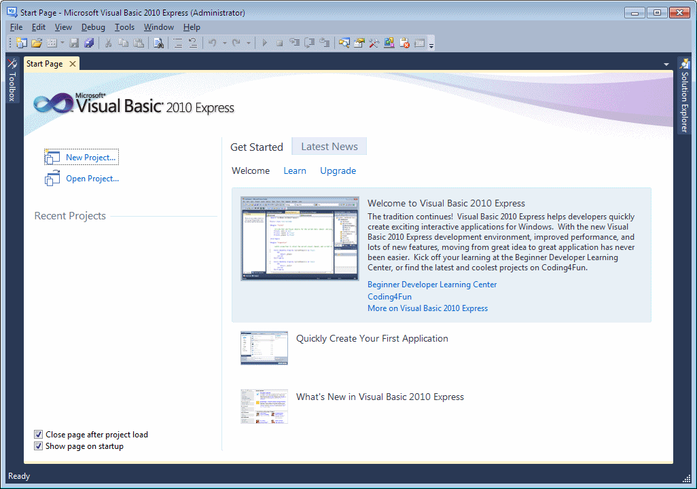

Slide 47
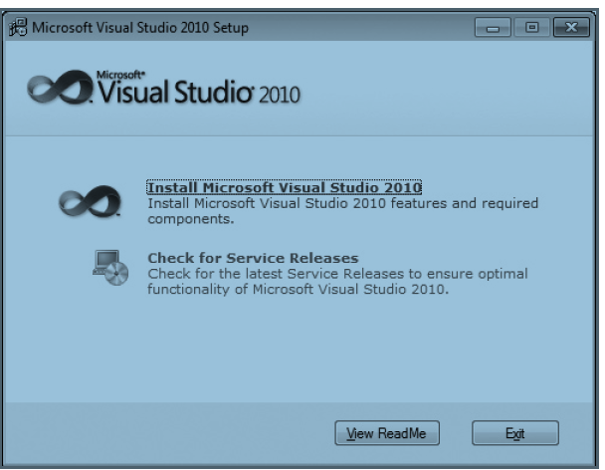

Slide 48
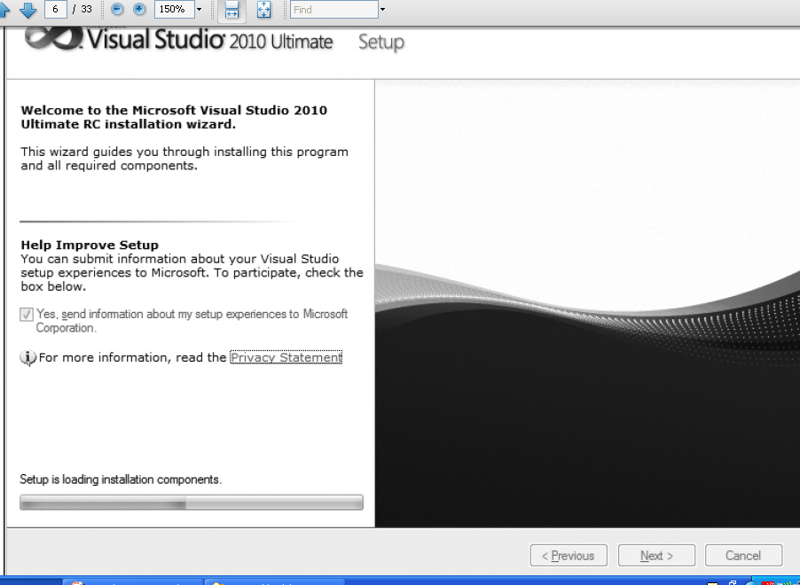

Slide 49
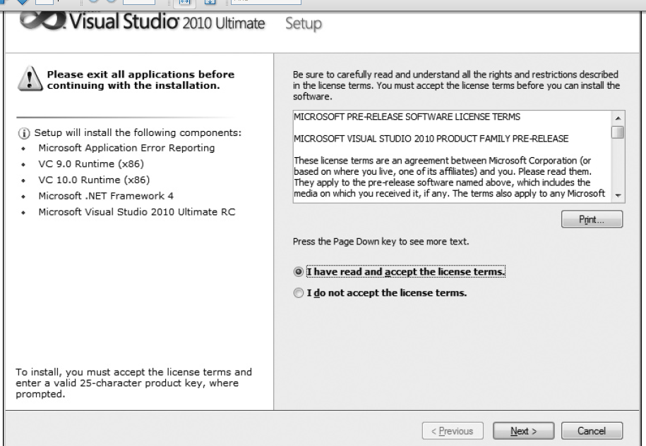

Slide 50
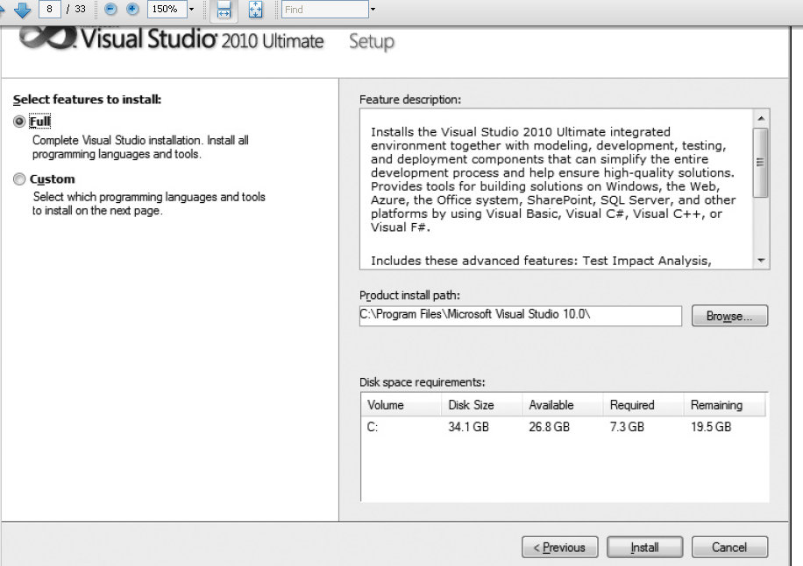

Slide 51
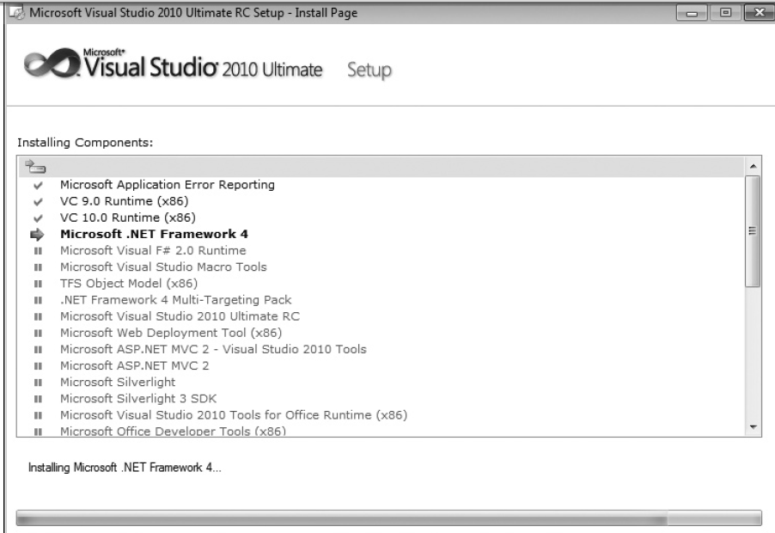

Slide 52
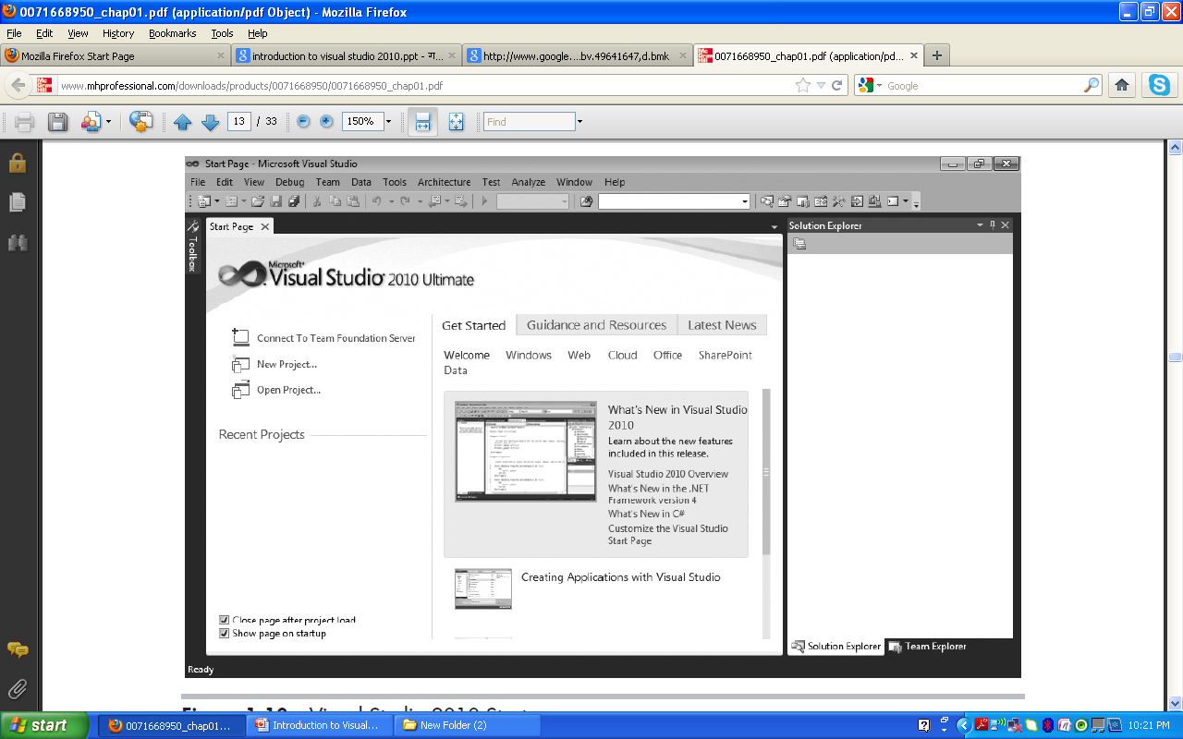
Starting the visual studio 2010

Slide 53
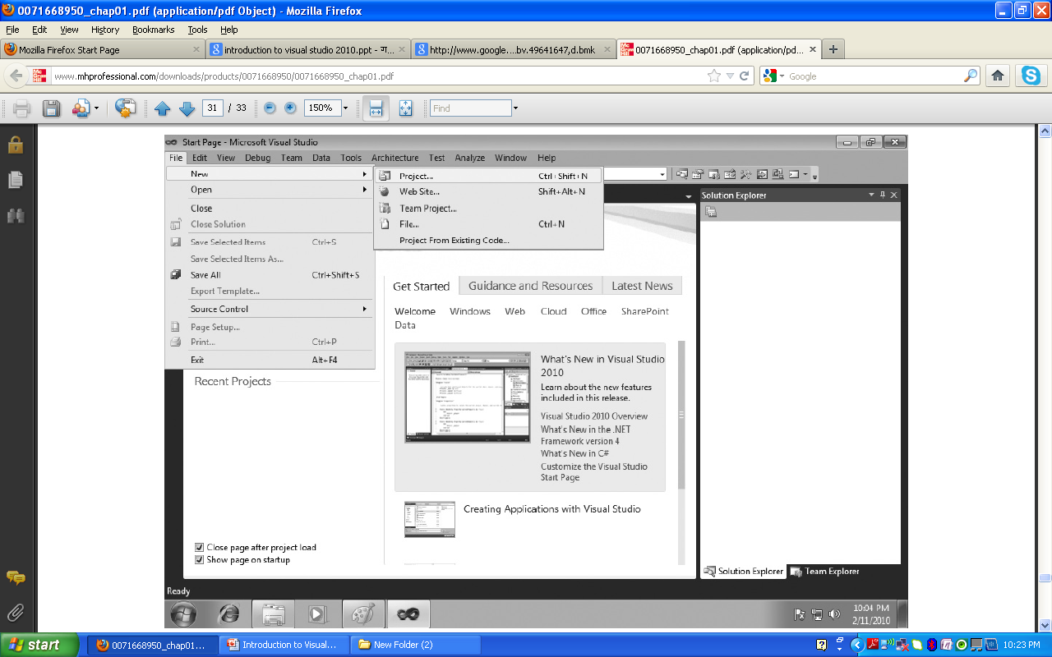
Selecting a new project

Slide 54
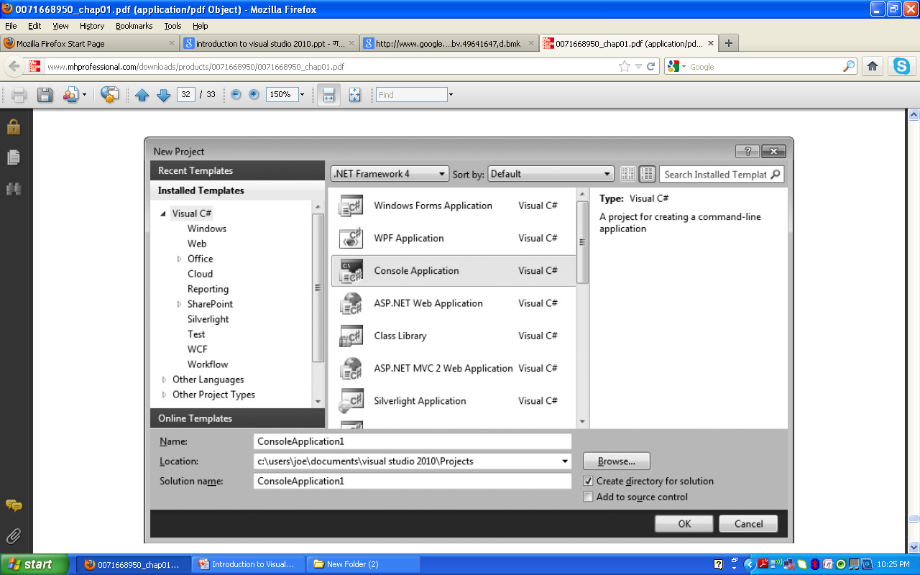
New project window

